Slide 1


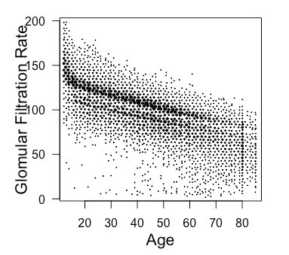
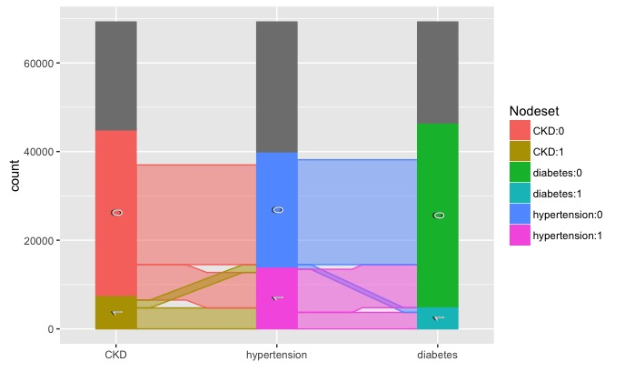
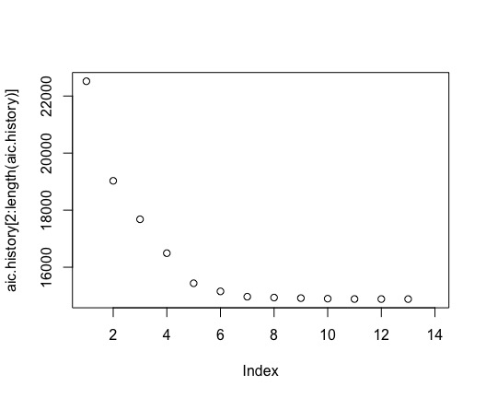
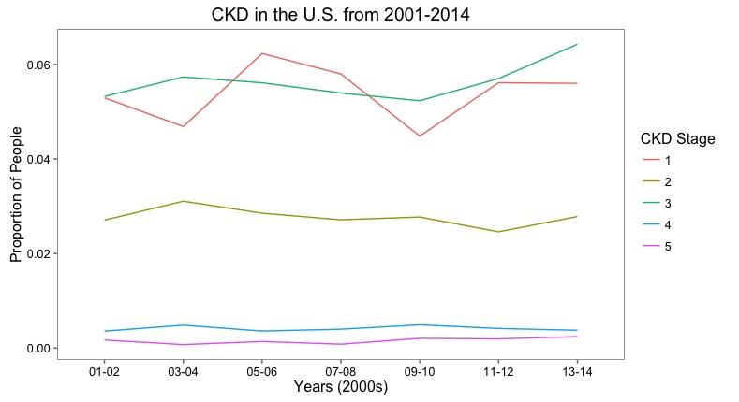
Predicting CKD and Identifying Potential Risk Factors
Gabriel Goulart, Nicholas Hertle, and Lydia Lucchesi
CKD
Chronic kidney disease, or CKD, is not easy to live with, especially for those in the late stages of the disease. Sadly, it affects roughly 20 million people living in the United States, and more likely than not, those battling CKD face other issues as well. Interested in this co-occurrence of disease, our research focuses on the association between CKD and other health-related problems in order to identify potential risk factors for CKD. Ultimately, we built a logistic regression model that predicts if a patient has CKD based on their current state of health, socioeconomic status, and demographic.
NHANES
The data for this study comes from the National Health and Nutrition Examination Survey conducted by the CDC every year. Each survey cycle consists of two years and attempts to obtain a representative sample of the United States’ population. Our dataset has 78,518 observations, contains 100 different variables, and spans 14 years (2001-2014). With the help of the ‘Survey’ package in R, we were able to account for high variance, a result of the complex survey method used by the CDC, and get a strong sense of what is happening among roughly 320 million people.
Methods
Conclusion
Logistic regression model and final error rate.
Thoughts on variables. Association.
Discussion
For NHANES, new individuals are surveyed each year, and geographic location is kept confidential. The inability to track the health of a single person over time prohibited us from looking for causes of CKD. Only association studies were possible.
While the ‘Survey’ package in R is incredibly helpful at properly weighting each observation, it does not work seamlessly with generic R functions, greatly limiting our analysis.
After removing all observations that contained a missing value, only 9.9% were left for analysis. Future studies could look at building models to predict missing values instead of removing them completely.
Acknowledgements
This project would not have been possible without the mentorship of Dr. Yanming Li, Dr. Jiang Kang, and Dr. Kevin He and also without the support of the Big Data Summer Institute. We are very thankful for the opportunity to do research at the University of Michigan.
Citations
T. Lumley (2014) "survey: analysis of complex survey samples". R package version 3.30.
Articles they provided for reading
1. Narrowed down variables of interest
through literature review,
visualizations, and chi-squared tests
Hexagonal binning was used to make sense of a scatterplot with many data points
Demonstrates strong linear relationship between age and estimated glomerular filtration rate
Parallel sets visualization used to understand relationships between categorical variables in multivariate datasets
2. Used both forward and backward selection to get models with the lowest AIC and BIC measurements…add more specific information......
3. Performed a k-fold cross validation to find the most useful logistic regression model for predicting CKD
Maintained consistency throughout the cross validation (which is not offered in the ‘Survey’ package) by manually adjusting for the weight of each observation.
Add more specific information about cross validation
Results
Logistic Model:
Error rate:
Regression diagnostics:

